Slide 1
Nuclear Fuel Performance
NE-533
Spring 2025

Slide 2
Last Time
Talked through numerical thermomechanics
All fuel performance codes: a) Numerically model the temperature in the fuel, b) Numerically model the stress in the cladding, c) Consider gap pressure, closure, and heat transfer
Some multiphysics fuel performance codes
FRAPCON/FRAPTRAN
BISON
Intro into material property evolution

Slide 3
Paper Project
Assigned papers uploaded to moodle with your name as a prefix
This will be a critical review of the paper, similar to what we do for QE2, but much shorter
Contextualize, summarize, and analyze
15-minute presentation that summarizes what was done in the paper, provides context on why it was done, and reviews what could or should have been done, or could be done next
All presentations will be submitted via moodle, due by end of the day on Mar. 3
Distance students will submit slides and a recording of their presentation
Presentations will take place in-class on Mar. 4 and Mar. 6

Slide 4
Material Property Evolution

Slide 5
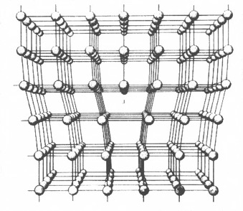
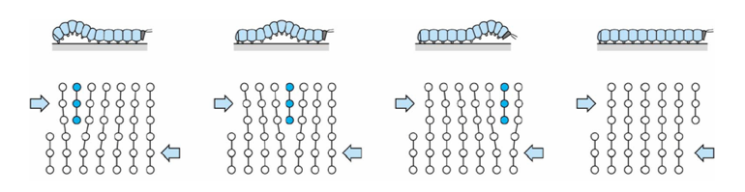
Dislocations are imperfections associated with a line of lattice sites (1D defect)
In a dislocation, an extra half plane of atoms is inserted into the lattice
When it moves, only a small number of bonds are broken at a time
Dislocation motion controls the plastic (permanent) deformation of crystalline materials

Slide 6
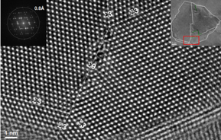
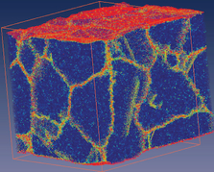
Grain boundaries
Materials are typically composed of various regions where the crystal lattice is oriented differently. These regions are called grains
When two grains meet, there is a plane of atoms that do not follow the crystal lattice called a grain boundary (2-D defect)
Most crystalline materials are polycrystalline, not single crystal
High-res transmission eleectron microscopy can also show individual atoms (palladium)
www.knmf.kit.edu/TEM.php
Atomistic simulation of grain boundaries in 3D

Slide 7
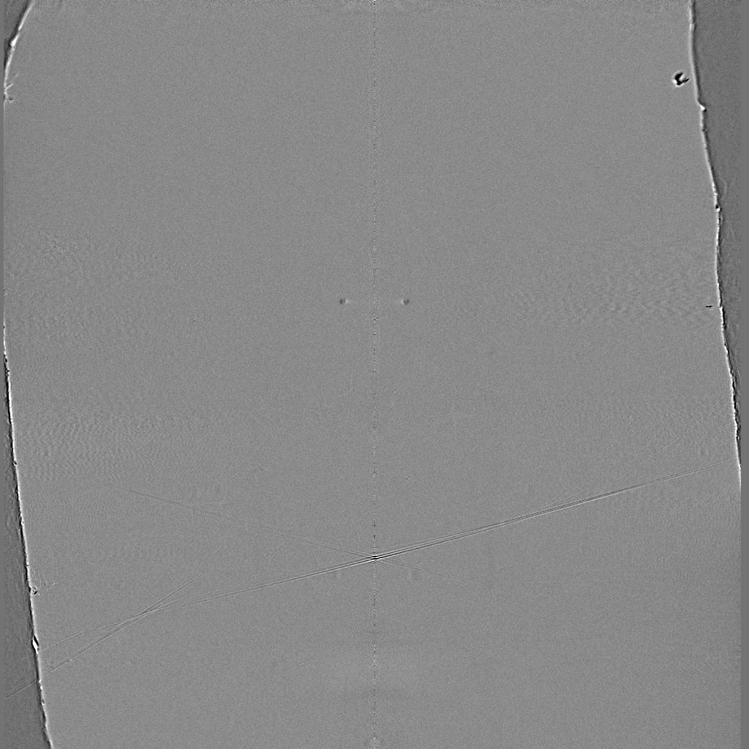
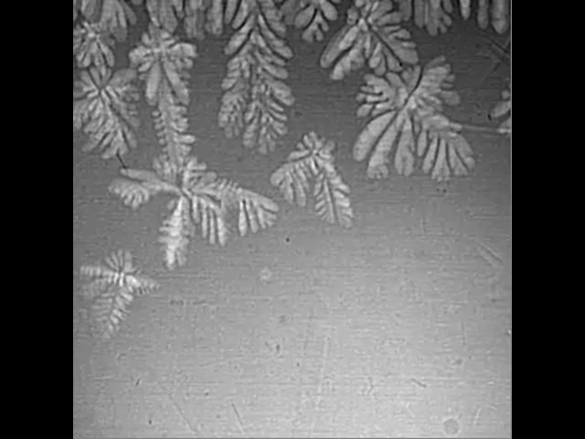
Metals are often cast, and polycrystals naturally form during casting

Slide 8
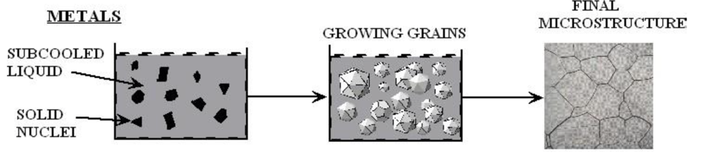
Polycrystals naturally form during casting
Solidification begins in different regions of the melt, each with a different orientation
Once the different regions meet, grain boundaries form between them

Slide 9
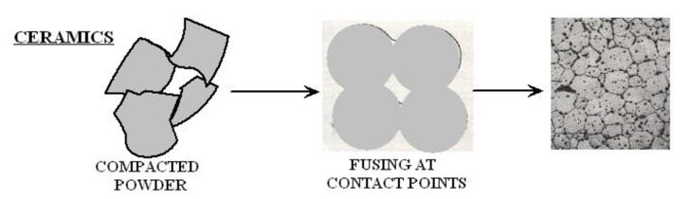
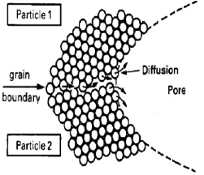
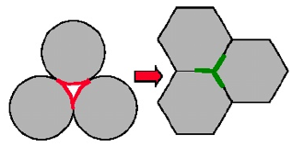
Ceramic sintering
Ceramics are typically sintered, and polycrystals also naturally form from sintering
In sintering, powders are compacted at high temperature
The particles are each oriented differently, and as they fuse, grain boundaries form
The differences between the grain orientations result in the grain boundary

Slide 10
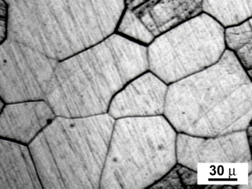
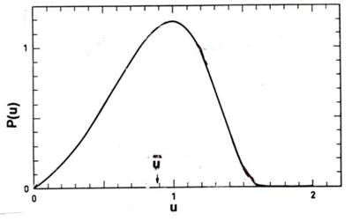
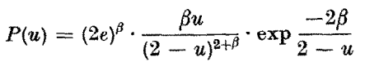
Distribution of grain sizes
In a polycrystal, there is also a distribution of grain sizes
Therefore, we commonly refer to the grain size distribution and the average grain size
The Hillert distribution is an analytical distribution for grain size
Real materials often vary from this behavior

Slide 11
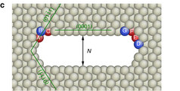
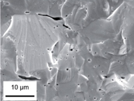
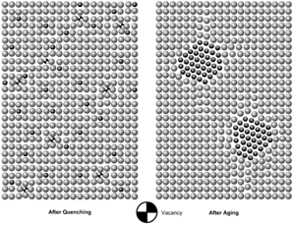
3D Defects
When point defects cluster, they form three dimensional defects
The energy of a point defect is reduced when several point defects cluster together
Larger clusters of vacancies are called voids
Clusters of impurity atoms are called precipitates

Slide 12
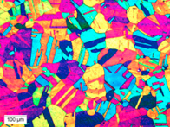
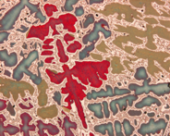
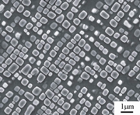
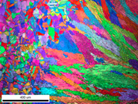
Microstructure
Material microstructure is the structure observable with 25x magnification
The microstructure includes grain structure, secondary phases, porosity, and more
The microstructure can strongly influence physical properties such as strength, toughness, ductility, hardness, corrosion resistance, high/low temperature behavior or wear resistance.
These properties in turn govern the application of these materials in industrial practice
Annealed Stainless Steel
Cast Bronze
Sintered UO2
Co-Al-W Superalloy
Friction stir welded stainless steel

Slide 13
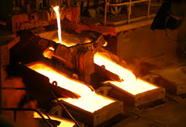
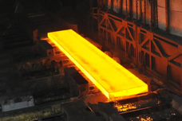
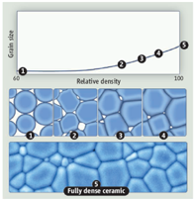
Material processing
The processes we use to make a material have a huge impact on its microstructure and properties
Casting – manufacturing process in which a liquid material is poured into a mold and then allowed to solidify
Can be used to make complex shapes
The solidified microstructure typically has properties that are far from ideal
Sintering – Forming a solid from a powder using heat and/or pressure without melting the material
Applicable to metals and ceramics
Difficult to obtain a material that is fully dense
Used to make fuel pellets
Post-fabrication processing
heat treatment
working

Slide 14
Material processing
Heat treatment: heating or cooling a material to extreme temperatures to get desired microstructure and properties
Used to control the rate of microstructure change, including diffusion, grain growth, or phase change
Annealing
heat and hold the material, which allows for any defects in the material to repair themselves
The metal is then allowed to cool back to room temperature at a slow pace to produce a more ductile crystalline structure
Quenching
heated to a temperature that transforms its internal structure, held at that temperature, then rapidly cooled
The quick cooling process locks in the high T structure, or forces phase transformation without the ability to relax stresses

Slide 15
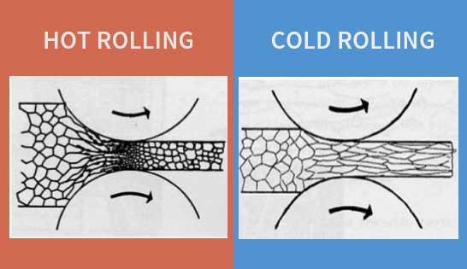
Material processing
Working: metalworking process that plastically deforms the alloy
Cold working occurs below the recrystallization temperature, hot working occurs above
By plastically deforming the material, we are increasing the number of dislocations and dislocation barriers, increasing the yield strength
Main types of working processes:
Squeezing (rolling/extrusion/drawing)
Bending (shaping)
Shearing (slitting)

Slide 16
Summary
Gap size changes due to thermal expansion, changing temperature profile
Often have displacements instead of strains, and can solve for stress via displacements
Fuel and pellet conditions change with time due to microstructure evolution
Atoms in the fuel and cladding materials are arranged in a crystal lattice
The crystal lattice is never perfect; it has defects
Point defects, dislocations, grain boundaries, voids and precipitates
All materials have defects, radiation damage causes many more defects
Microstructure can be tailored through processing, during fabrication or post-fabrication

Slide 17
UO2 Radiation effects

Slide 18
Radiation Damage
The macroscopic and observable results of exposure of solids to energetic particles are collectively known as radiation effects
Heat production from the nuclear fuel to generate electricity ensues mostly from the slow down of the fission products by nuclear or electronic interactions
As a direct consequence, there are also defects created along the path of the fission fragments leading to modification of the physical properties of the fuel
Most Frenkel defects (interstitial-vacancy pair) are produced by secondary collision cascades
Local charge neutrality prevents the formation of interstitials and vacancies as independent processes, as the cations and anions are charged species
In UO2, two anion vacancies need to be created for each cation vacancy, forming a Schottky trio
The dominant defect type is anion Frenkel pairs

Slide 19
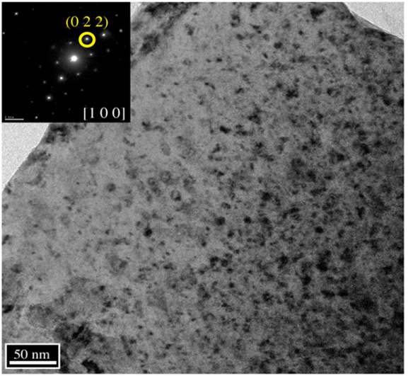
Loop Formation
Dislocations generally a mixture of screw and edge components in the shape of a loop
The most important slip system in UO2 is the one which minimizes the electrostatic energy, the easy slip along {100}<110> tends to minimize the intense repulsive force between cations
Prismatic loops are of interstitial type and consist of a disc-shaped layer of defects in a cluster
This defect cluster is more energetically favorable than dispersed defects in the bulk
Vacancy clusters will form into voids
Prismatic loops in UO2 from alpha particle irradiation

Slide 20
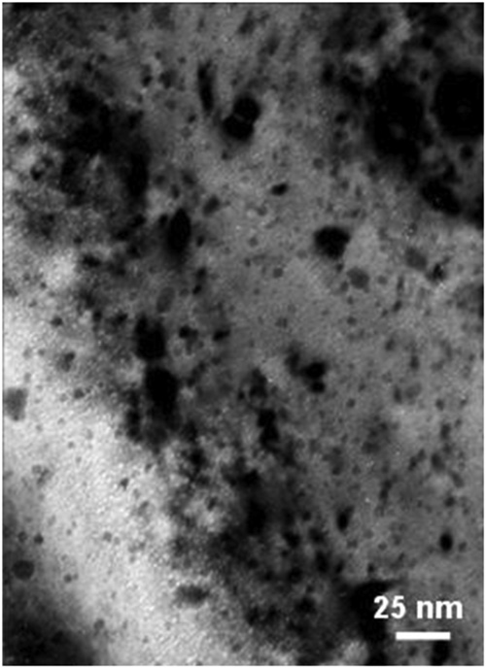
Voids
Due to preferential absorption of interstitials at dislocations, we are left with a slight excess of vacancies in the bulk to nucleate and grow voids
Void nucleation can occur homogeneously by the collection of vacancies in the matrix, or heterogeneously at structural features (precipitates, grain boundaries, etc.)
The vacancy-rich radiation damage core is considered to be an important void nucleation mechanism in UO2
Vacancy diffusion then allows void growth
Gas atoms can often serve to stabilize small voids
Voids (bright spots) from alpha irradiation in UO2

Slide 21
Radiation Effects
Chemistry changes
two fission products are generated from each fission, resulting up to about 3% of the chemical species present at the end of life for commercial fuel
the amount of fission products change both chemical and physical properties
Physical property changes
The physical effects caused by atomic displacements are rather complex and depend on the relative sink strengths of a given material for interstitials and vacancies and on the temperature
lattice parameter, thermal conductivity, elasticity, formation of the high burnup structure

Slide 22
Thermal Conductivity Degradation
One of the major effects of defect formation is the degradation of thermal diffusivity, due to phonon scattering
Results obtained on irradiated UO2 show that the thermal conductivity is decreasing with increasing burn-up, and that at equal burn-up, samples with higher irradiation temperatures have higher thermal conductivity
There are mesoscopic and atomistic features that affect the thermal conductivity
The porosity existing in fresh fuels evolves during irradiation and has a strong impact on heat transport, because voids/bubbles have significantly lower kth than the lattice
Precipitates are formed by fission products that are insoluble in the UO2 lattice, forming oxide or metallic inclusions: can use composite theory to get effective thermal conductivities; typically, these precipitates INCREASE the thermal conductivity of the fuel

Slide 23
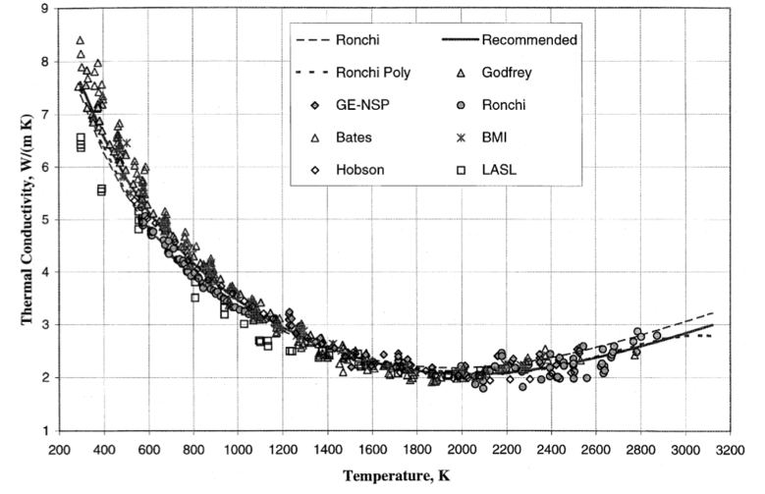
Thermal Conductivity Degradation
Actinides, rare earths, and transition metals can form mixed oxides with UO2 (soluble fission products): these atoms act as phonon scattering centers as a result of the differences in bonding, radii, or mass, and thus decrease kth
Volatile fission products/gases are partially in solution and partially in bubbles, where they act as phonon scatterers or as low kth composite fractions
Point defects and extended defects contribute to the degradation of the thermal conductivity by scattering or limiting the mean free path of the phonons

Slide 24
UO2 Thermal Conductivity
We have established correlations for thermal conductivity of fresh UO2 fuel as a function of temperature
Where t = T/1000
The first part of the equation describes the phonon interactions
The second part describes electronic transport which becomes significant at high temperature

Slide 25
UO2 Thermal Conductivity
UO₂ thermal conductivity is low and decreases more during reactor operation
The thermal conductivity has been collected after various amounts of burnup to make empirical fits

Slide 26
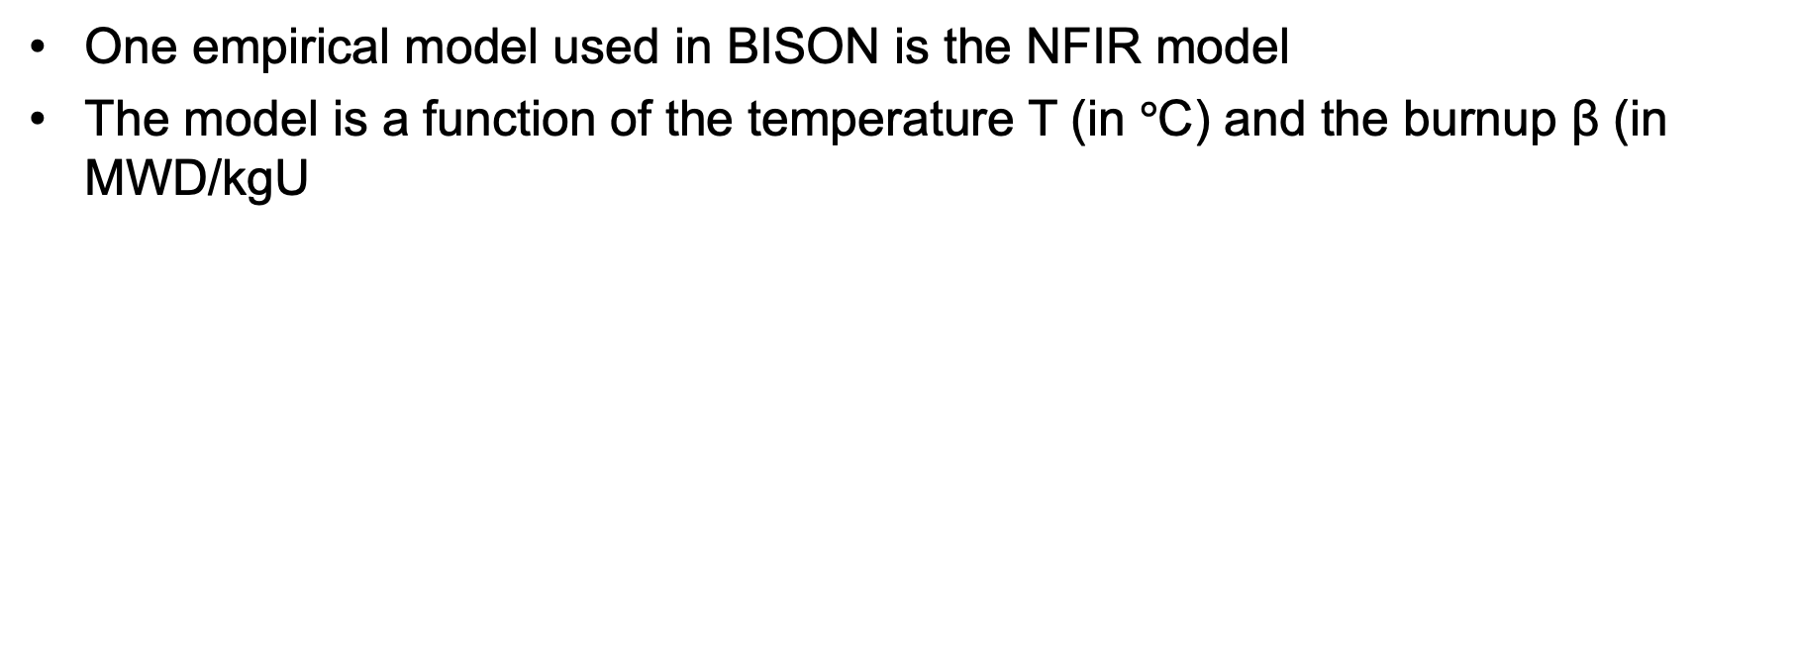
UO2 Thermal Conductivity
One empirical model used in BISON is the NFIR model
The model is a function of the temperature T (in $°$C) and the burnup β (in MWD/kgU

Slide 27
UO2 Thermal Conductivity
The R_{f} function switches between two k_{ph} functions, accounting for thermal recovery

Slide 28
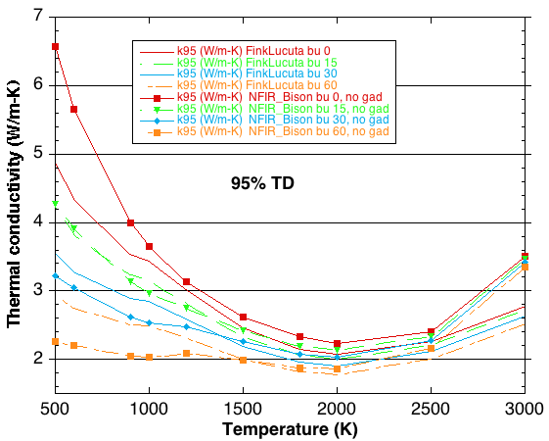
MOOSE/BISON Models
https://mooseframework.inl.gov/bison/source/materials/UO2Thermal.html
Fink-Lucuta
Halden
NFIR
NFI
Ronchi-Staicu
Toptan (NCSU alum)

